Slide 1
Artificial Intelligence (AI)
Topic 2: Problem Solving Agents (Part -II)

Slide 2
Agenda
Problem-solving agents
Problem types
Problem formulation
Example problems
Basic search algorithms
Learning Outcomes : Intelligent Agents
Methodology and Assessment Criteria for the Subject

Slide 3
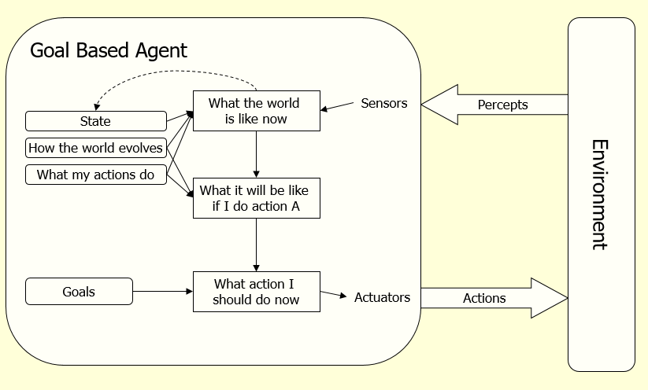
Problem Solving Agents
Function Simple-Problem-Solving-Agent( percept ) returns action
Inputs: percept a percept
Static: seq an action sequence initially empty
state some description of the current world
goal a goal, initially null
problem a problem formulation
state <- UPDATE-STATE( state, percept )
if seq is empty then do
goal <- FORMULATE-GOAL( state )
problem <- FORMULATE-PROBLEM( state, goal )
seq <- SEARCH( problem ) # SEARCH
action <- RECOMMENDATION ( seq ) # SOLUTION
seq <- REMAINDER( seq )
return action # EXECUTION

Slide 4
Goal based Agent(s)
Assumes the problem environment is:
Static
The plan remains the same
Observable
Agent knows the initial state
Discrete
Agent can enumerate the choices
Deterministic
Agent can plan a sequence of actions such that each will lead to an intermediate state
The agent carries out its plans with its eyes closed
Certain of what’s going on
Open loop system

Slide 5
Well Defined Problems and Solutions
A problem
Initial state
Actions and Successor Function
Goal test
Path cost

Slide 6
Problem solving
We want:
To automatically solve a problem
We need:
A representation of the problem
Algorithms that use some strategy to solve the problem defined in that representation

Slide 7
Problem representation
General:
State space: a problem is divided into a set of resolution steps from the initial state to the goal state
Reduction to sub-problems: a problem is arranged into a hierarchy of sub-problems
Specific:
Game resolution
Constraints satisfaction

Slide 8
States
A problem is defined by its elements and their relations.
In each instant of the resolution of a problem, those elements have specific descriptors (How to select them?) and relations.
A state is a representation of those elements in a given moment.
Two special states are defined:
Initial state (starting point)
Final state (goal state)

Slide 9
State modification: successor function
A successor function is needed to move between different states.
A successor function is a description of possible actions, a set of operators. It is a transformation function on a state representation, which convert it into another state.
The successor function defines a relation of accessibility among states.
Representation of the successor function:
Conditions of applicability
Transformation function

Slide 10
State space
The state space is the set of all states reachable from the initial state.
It forms a graph (or map) in which the nodes are states and the arcs between nodes are actions.
A path in the state space is a sequence of states connected by a sequence of actions.
The solution of the problem is part of the map formed by the state space.

Slide 11
Problem solution
A solution in the state space is a path from the initial state to a goal state or, sometimes, just a goal state.
Path/solution cost: function that assigns a numeric cost to each path, the cost of applying the operators to the states
Solution quality is measured by the path cost function, and an optimal solution has the lowest path cost among all solutions.
Solutions: any, an optimal one, all. Cost is important depending on the problem and the type of solution sought.

Slide 12
Problem description
Components:
State space (explicitly or implicitly defined)
Initial state
Goal state (or the conditions it has to fulfill)
Available actions (operators to change state)
Restrictions (e.g., cost)
Elements of the domain which are relevant to the problem (e.g., incomplete knowledge of the starting point)
Type of solution:
Sequence of operators or goal state
Any, an optimal one (cost definition needed), all

Slide 13
Example: Water Pouring (1)
Given a 4 gallon bucket and a 3 gallon bucket, how can we measure exactly 2 gallons into one bucket?
There are no markings on the bucket
You must fill each bucket completely

Slide 14
Example: Water Pouring (2)
Initial state:
The buckets are empty
Represented by the tuple ( 0 0 )
Goal state:
One of the buckets has two gallons of water in it
Represented by either ( x 2 ) or ( 2 x )
Path cost:
1 per unit step

Slide 15
Example: Water Pouring (3)
Actions and Successor Function
Fill a bucket
(x y) -> (3 y)
(x y) -> (x 4)
Empty a bucket
(x y) -> (0 y)
(x y) -> (x 0)
Pour contents of one bucket into another
(x y) -> (0 x+y) or (x+y-4, 4)
(x y) -> (x+y 0) or (3, x+y-3)

Slide 16
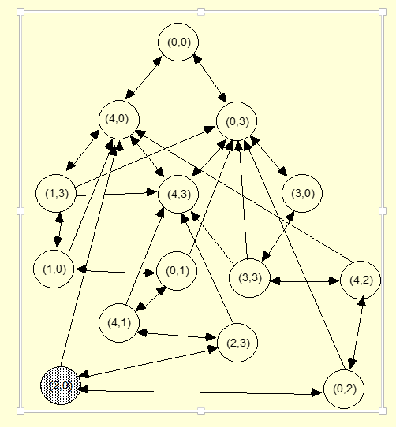
Example: Water Pouring (4)

Slide 17
Example: Eight Puzzle (1)
States:
Description of the eight tiles and location of the blank tile
Successor Function:
Generates the legal states from trying the four actions {Left, Right, Up, Down}
Goal Test:
Checks whether the state matches the goal configuration
Path Cost:
Each step costs 1
7 | 2 | 4
5 |  | 6
8 | 3 | 1
1 | 2 | 3
4 | 5 | 6
7 | 8

Slide 18
Example: Eight Puzzle (2)
Eight puzzle is from a family of “sliding –block puzzles”
NP Complete (NP-complete problem, a class of computational problems for which no efficient solution algorithm has been found)
8 puzzle has 9!/2 = 181440 states
15 puzzle has approx. 1.3*10¹² states
24 puzzle has approx. 1*10²⁵ states

Slide 19
Example: Eight Queens (1)
Place eight queens on a chess board such that no queen can attack another queen
No path cost because only the final state counts!
Incremental formulations
Complete state formulations
Q
Q
Q
Q
Q
Q
Q
Q

Slide 20
Example: Eight Queens (2)
Q
States:
Any arrangement of 0 to 8 queens on the board
Initial state:
No queens on the board
Successor function:
Add a queen to an empty square
Goal Test:
8 queens on the board and none are attacked
64*63*…*57 = 1.8*10¹⁴ possible sequences
Ouch!
Q
Q
Q
Q
Q
Q
Q

Slide 21
Example: Eight Queens (3)
Q
States:
Arrangements of n queens, one per column in the leftmost n columns, with no queen attacking another are states
Successor function:
Add a queen to any square in the leftmost empty column such that it is not attacked by any other queen.
2057 sequences to investigate
Q
Q
Q
Q
Q
Q
Q

Slide 22
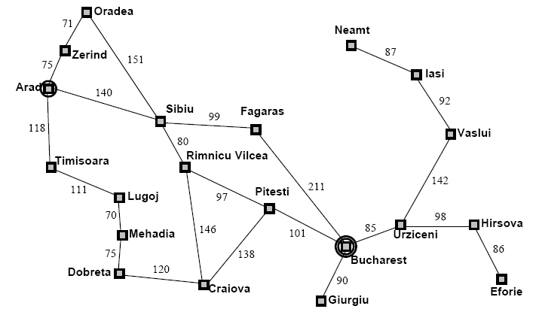
Example: Map Planning (1)

Slide 23
Searching For Solutions (1)
Initial State
e.g. “At Arad”
Successor Function
A set of action state pairs
S(Arad) = {(Arad->Zerind, Zerind), …}
Goal Test
e.g. x = “at Bucharest”
Path Cost
sum of the distances traveled

Slide 24
Searching For Solutions (2)
Having formulated some problems…how do we solve them?
Search through a state space
Use a search tree that is generated with an initial state and successor functions that define the state space

Slide 25
Searching For Solutions (3)
A state is (a representation of) a physical configuration
A node is a data structure constituting part of a search tree
Includes parent, children, depth, path cost
States do not have children, depth, or path cost
The EXPAND function creates new nodes, filling in the various fields and using the SUCCESSOR function of the problem to create the corresponding states

Slide 26
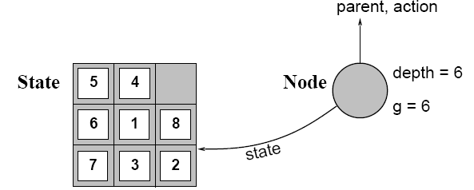
Searching For Solutions (4)

Slide 27
Learning Outcomes with the Topic
Understanding the need of Search Algorithms

Slide 28
Methodology And Assessment Criterias
Class Assignment(s)
Each chapter being covered will have one assignment. The Case Studies will be given in line to the Changing with Speed across IT Projects in Kirirom
Internal Exam(s)
There will be 2 exams
Model Exam
There will be one Model Exam.
Semester Exam
There will be 1 Semester Exam

Slide 29

Thank You !
“An Algorithm Must Be Seen to Be Believed”
- Donald Knuth

